Slide 1
2015-2017
Private Recertification
Label Review & Update
Worker Protection Standard
NCDA&CS Pesticide Section

Slide 2
2015-2017 Private Recertification
Topics
Label Requirements
Off-Target Drift
Worker Protection Standard
Notes:
The topics for Private Recertification 2015-2017 include: Label information and review with a focus on Pollinator Protection and Off Target Drift. A review of the Worker Protection Standard and a heads up for possible changes coming to WPS. A look at Chemigation label requirements and the regulations enforced in North Carolina. A review of pesticide and container disposal along with new information of bulk pesticide container recycling. Clarification on bulk containers for growers.

Slide 3
“The Label is the Law”
Pesticide Labels
Read the label thoroughly
Precautionary statements
Environmental hazards
Directions for use
Storage and Disposal
Notes:
All pesticide labels have the statement “It is a violation of Federal law to use this product in a manner inconsistent with its labeling. All applicators should keep this statement in mine when planning to purchase and use a pesticide product.

Slide 4
Important information you should know where to find
Brand name of pesticide
EPA Registration Number
&
EPA Establishment Number
Active & inert ingredients
Keep Out Of
Reach Of Children
Signal word
(Caution, Warning, Danger)
Notes:
Important information that is always found on a restricted use pesticide label. Most of the information that is required for pesticde record keeping can be found on this part of the label.

Slide 5
Signal Words
The Signal Word describes the potential for the product to harm humans.
Relative Toxicity
MORETOXIC
LESS TOXIC
Caution
Warning
Danger
Danger-Poison
Signal Words Found on Pesticide Labels
Notes:
CAUTION means the pesticide product is slightly toxic if eaten, absorbed through the skin, inhaled, or it causes slight eye or skin irritation.
WARNING indicates the pesticide product is moderately toxic if eaten, absorbed through the skin, inhaled, or it causes moderate eye or skin irritation.
DANGER means that the pesticide product is highly toxic by at least one route of exposure. It may be corrosive, causing irreversible damage to the skin or eyes. Alternatively, it may be highly toxic if eaten, absorbed through the skin, or inhaled. If this is the case, then the word “POISON” must also be included in red letters on the front panel of the product label.
The skull and crossbones symbol and the word “Poison” identify pesticide products that are determined to be in Toxicity Category I based on at least one of the following acute toxicity studies: acute oral, acute dermal, or acute inhalation.
Signal words help alert users to special hazards of a pesticide product. The signal word can be used by shoppers to select the least toxic product(s) of those that are sufficiently effective. Regardless of the signal word on the pesticide product, it is important to remember that every product still has the potential to poison (i.e., is harmful at high doses). Special care should be taken to carefully follow all of the directions on the label, each time a pesticide product is used.

Slide 6
Precautionary Statements
Hazards to Humans & Domestic Animals
Personal Protective Equipment (PPE)
First Aid
Environmental Hazards: Fish & Aquatic, Bees, Birds, Wildlife
Physical & Chemical Hazards
Notes:
Precautionary statements are designed to provide pesticide users with information regarding the toxicity, irritation, and sensitization hazards associated with the use of a pesticide, as well as application instructions and information to reduce exposure potential. Precautionary statements include child hazard warnings, engineering control statements, environmental hazard statements, first aid statements, hazards to humans and domestic animals statements, personal protective equipment (PPE) statements, physical or chemical hazard statements, signal words, user safety recommendations, and user safety requirements.

Slide 7
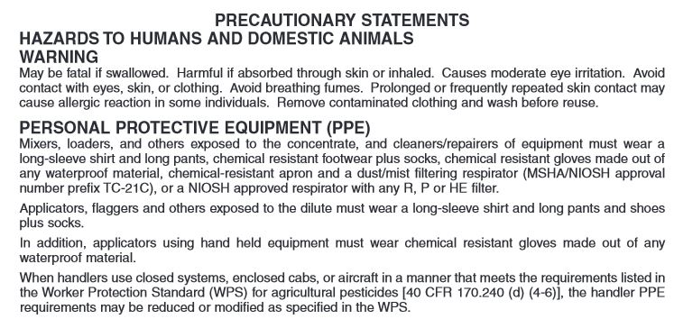
Precautionary Statements
Notes:
The Hazards to Humans and Domestic animals advisory provides precautionary language advising of potential hazards to humans and domestic animals.
PPE requirements for applicators can be found in this section of the pesticide label.

Slide 8
Pesticide Labels
Labels are reviewed by EPA on a 15 year cycle to assure that all information and directions meet safety standards.
Label changes are made if adverse effects have been reported that involve humans or the environment.
Recent areas of concern are:
- Fumigation
- Pollinators
- Off Target Drift
Notes:
EPA is required by the Food Quality Protection Act to review registered pesticides every 15 years.

Slide 9
CERTIFICATION CATEGORIES FOR 2016
Soil Fumigation
Applicators must take a written exam or complete the EPA online training to obtain the soil fumigation category.
EPA online training will only be available for 2016 in NC
Applicators that have completed the initial soil fumigation training can now obtained recertification credits:
1 hour of soil fumigant training for the 3 year recertification period. (Z1)
Soil fumigation will be a category (Z1) for private applicator certification.
In the future, a Commodity fumigation (Z2) category will also be required.
Notes:
Starting in 2016 the Private Applicator Certification will have a category for soil fumigation.
Soil fumigation labels require that the Applicator in Charge be trained every 3 years in soil fumigation. Those applicators that have completed the initial training, either through the EPA online training or by face to face trainings which were held at various locations across the state, now have the option to work though the EPA online training again or attend a recertification class in soil fumigation.
One hour of soil fumigation (Z1) credit during the 3 year certification period will complete the requirements for the soil fumigant label.
After January 1, 2017 the EPA online training will no longer be an option in North Carolina.
When recertification is not obtained
Commodity fumigation will require a

Slide 10
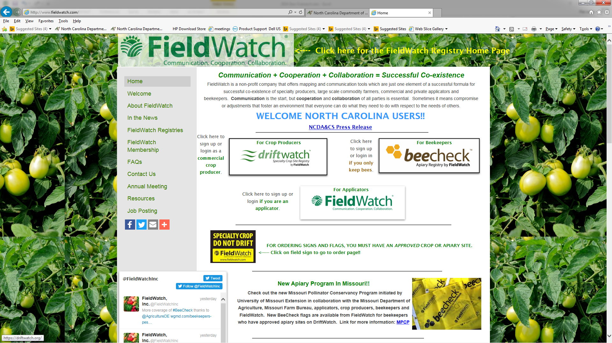
FieldWatch – DriftWatch
Specialty Crop Site Registry
Notes:
The N.C. Department of Agriculture and Consumer Services' Pesticide Section, with funding from the Pesticide Environmental Trust Fund, has purchased DriftWatch software, a voluntary communication tool that enables crop producers, beekeepers, and pesticide applicators to work together to protect specialty crops and apiaries through use of the DriftWatch registry mapping program.

Slide 11
FieldWatch – DriftWatch
Specialty Crop Site Registry
FieldWatch – DriftWatch - BeeCheck
FieldWatch - a non-profit company created to develop and operate the DriftWatch Specialty Crop Site Registry
DriftWatch - a web based mapping tool created to promote communications between producers of specialty crops and pesticide applicators in support of ongoing stewardship activities
Designed to alert applicators where specialty crop fields and beehives are located before their applications of chemicals
BeeCheck – a web based mapping tool created for beekeepers (hobby, sideline, and commercial) to map apiaries, purchase signs, and flags.
Notes:
FieldWatch, Inc. is a non-profit company created to develop and expand the operation of the DriftWatch Specialty Crop Site Registry. To support the rapid growth of DriftWatch outside of Indiana, Purdue University collaborated with other agricultural stakeholder groups in the creation of a non-profit corporation called FieldWatch in December 2013. The new company, which is located off-campus at the Purdue Research Park in West Lafayette, IN, has fully assumed the operational responsibilities of DriftWatch and developed a national platform for the website. DriftWatch is a voluntary online specialty crop site registry and mapping program created by Purdue's Agriculture Department. The University's successful web based program, launched in Indiana in 2008, has been effective in allowing both farmers and applicators to identify, map and communicate where high-value pesticide-sensitive crops are being grown as part of ongoing stewardship activities. DriftWatch has quickly caught the attention of other states and provinces in Canada. As a primary stakeholder, the respective state departments of agriculture provide a key leadership role in implementing, administering and financially supporting this effective stewardship communication tool.
DriftWatch is a voluntary online specialty crop site registry and mapping program created by Purdue's Agriculture Department. The University's successful web based program, launched in Indiana in 2008, has been effective in allowing both farmers and applicators to identify, map and communicate where high-value pesticide-sensitive crops are being grown as part of ongoing stewardship activities. DriftWatch has quickly caught the attention of other states and provinces in Canada. As a primary stakeholder, the respective state departments of agriculture provide a key leadership role in implementing, administering and financially supporting this effective stewardship communication tool.

Slide 12
FieldWatch – DriftWatch
Specialty Crop Site Registry
DriftWatch Website
An easy-to-use, reliable, accurate and secure on-line mapping tool intended to enhance communications that promote awareness and stewardship activities between producers of specialty crops, beekeepers, and pesticide applicators to reduce incidences of drift.
FREE - EASY
https://nc.driftwatch.org/
Communication + Cooperation + Collaboration = Successful Co-existence
Notes:
https://driftwatch.org/

Slide 13
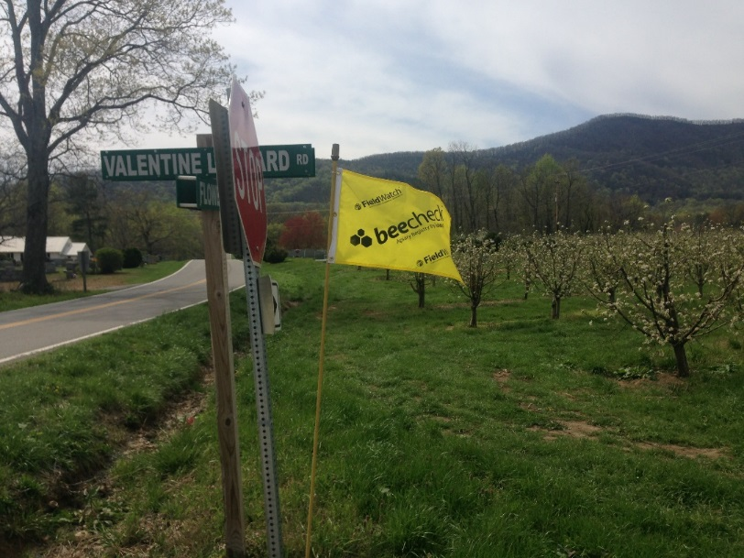
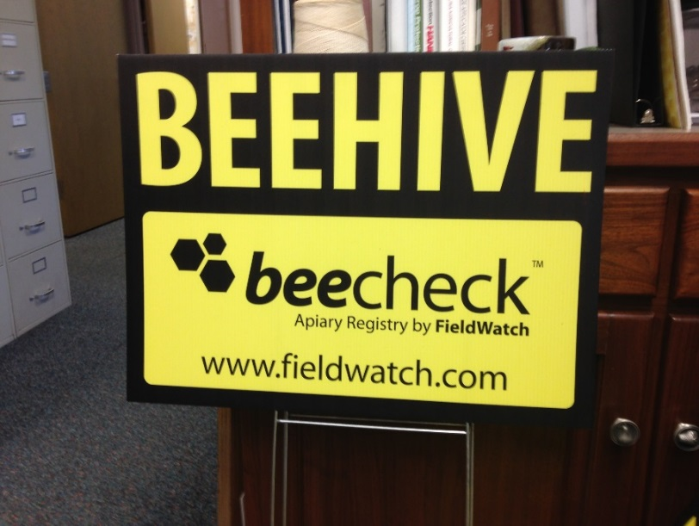
Be on the Lookout for Signs & Flags
Notes:
Signs and flags are now available to place near bee yards and specialty crops to alert applicators that special care is needed in these areas during pesticide applications.

Slide 14
Pesticide Concerns
Another area of concern is pesticide
DRIFT
The airborne movement of pesticides resulting from the application of pesticides such as to carry the pesticides beyond the target area
Notes:
Pesticide drift is the movement of pesticide dust or droplets through the air at the time of application or soon after, to any site other than the area intended. Pesticide droplets are produced by spray nozzles used in application equipment for spraying pesticides on crops, forests, turf and home gardens. Some other pesticides are formulated as dusts with very fine particles.
Droplets and dust particles can be carried by the wind some distance from the application site and be deposited on other areas, exposing people (such as nearby farmworkers and residents), wildlife, and plants to pesticides that can affect their health and the environment and cause property damage.

Slide 15
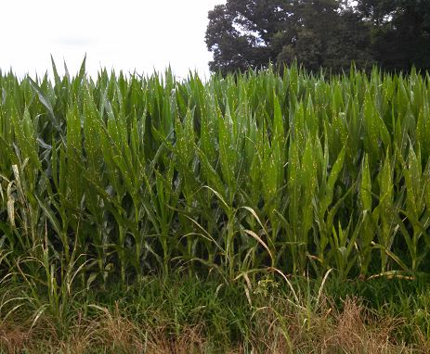
Pesticide Concerns
Herbicide Damage
from Drift
Notes:
Examples of herbicide damage from drift.

Slide 16
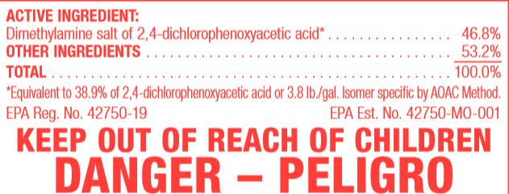
Notes:
Drift label language to help applicators prevent drift from target locations.

Slide 17
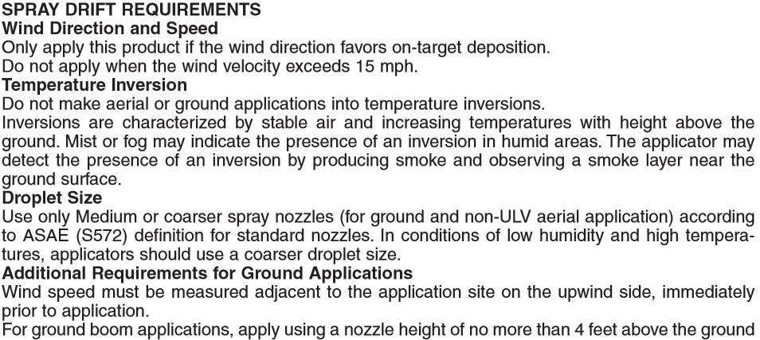
Notes:
Pesticide drift damage involving herbicides is usually easily seen Insecticide label drift requirement

Slide 18
Notes:
Additional off target movement requirements.

Slide 19
Remember NC Drift Law… Regardless of the Label
02 NCAC 09L .1404 DRIFT CONTROL
No person shall apply a pesticide(s) under such conditions that drift from pesticide(s) particles or vapors results in adverse effect.
Notes:
North Carolina Pesticide Rules and Regulations
02 NCAC 09L .1404 DRIFT CONTROL
No person shall apply a pesticide(s) under such conditions that drift from pesticide(s) particles or vapors results in adverse effect.
History Note: Authority G.S. 143‑458; 143‑463;
Eff. August 1, 1985.

Slide 20
Worker Protection Rule Changes
Starting in 2017
EPA Worker Protection Standard
Rule Changes
Some of those changes include:
Annual Worker and Handler Training
Notification
Hazard Communication
Decontamination Supplies
Respirator Use, 29 CFR 1910.134 Requirements
Notes:
The new proposed EPA worker protection rule changes are in a review period at this time.

Slide 21
Compliance Dates
Compliance with most new requirements by Jan 2, 2017
Except:
New Training Material
New Safety Poster
AEZ (Application Exclusion Zone)
Compliance with all requirements by Jan 2, 2018
Notes:
The new proposed EPA worker protection rule changes are in a review period at this time.

Slide 22
Pesticide Safety Training
Previously
Pesticide safety training every 5 years
Revision
Pesticide training every year
Expand training content [Delayed implementation]
Require recordkeeping of training for 2 years
Provide worker or handler a copy upon request
No “grace period”
Train-the-trainer programs must be approved by EPA and are available on line.
All resources available - Pesticide Education Resource Collaborative http://pesticideresources.org//index.html
Notes:
The new proposed EPA worker protection rule changes are in a review period at this time.

Slide 23
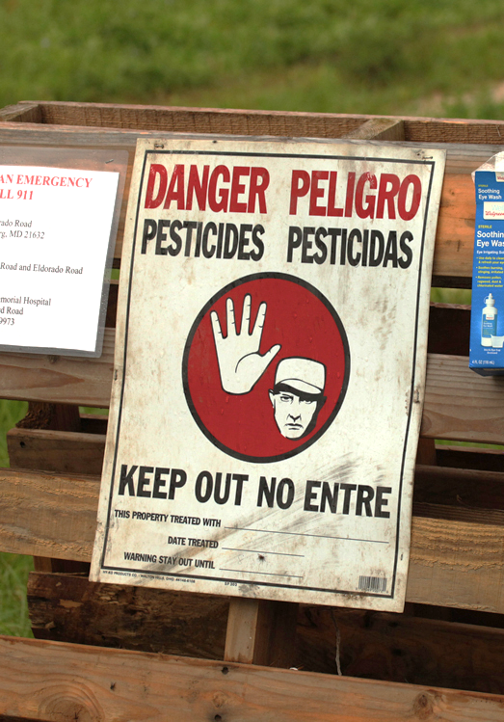
Notification
Previously
Oral or posted notification of outdoor treated areas unless labeling requires both
Workers entering when restricted-entry interval (REI) in effect (early-entry workers) must receive PPE
Revision
Post outdoor treated areas when REI is greater than 48 hours
Early-entry workers must be provided PPE & oral notification of:
information about the pesticide application
specific task to be performed
amount of time that the worker is allowed to remain in the treated area
the PPE required by the label
Notes:
The new proposed EPA worker protection rule changes are in a review period at this time.

Slide 24
Hazard Communication
Previously
Post application-specific information at central display until 30 days after REI expires
Available to worker or handler only during display period
Revision
Hazard information includes the application-specific information and the pesticide safety data sheets (SDSs)
Must be posted within 24 hours of the application or prior to worker entry
Notes:
The new proposed EPA worker protection rule changes are in a review period at this time.

Slide 25
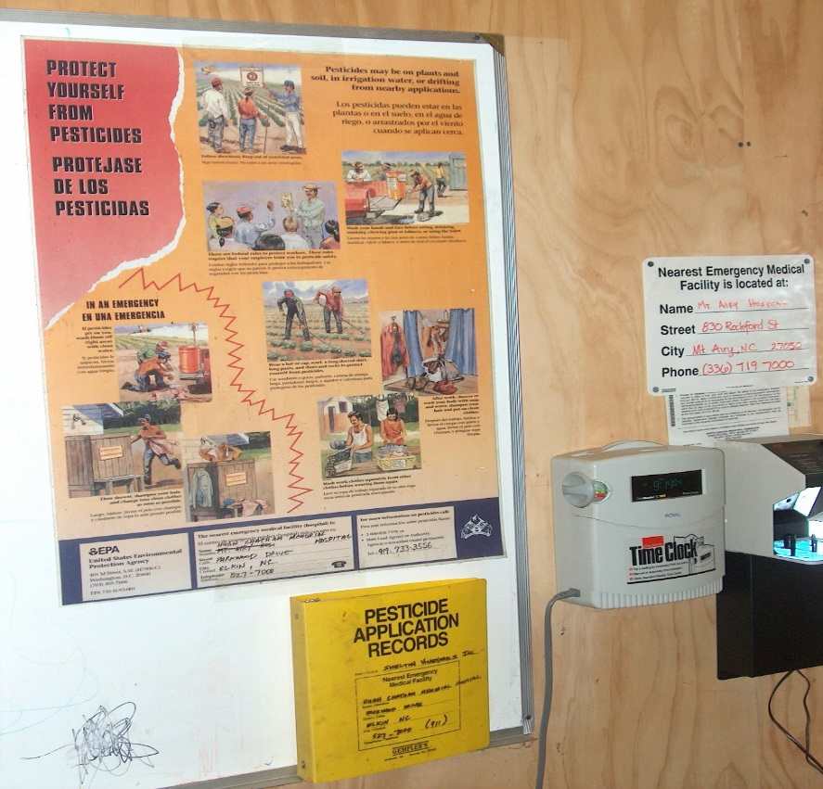
Hazard Communication
Revision
Post hazard information at central display for 30 days after REI expires and retain for 2 years
Access available from display period through retention to:
Employee (upon oral or written request)
Treating medical personnel and persons working under their supervision (oral or written request)
Designated representative (written request only)
Notes:
The new proposed EPA worker protection rule changes are in a review period at this time.

Slide 26
Pesticide Safety Information
Previously
Safety poster displayed at central location
Emergency Medical Facility
Revision
Safety information displayed at central location and permanent decontamination sites (11 or more workers)
Additional information required on display – State Lead agency Contact Information
[Delayed implementation]
Notes:
The new proposed EPA worker protection rule changes are in a review period at this time.

Slide 27
Minimum Age for Handlers & Early-Entry Workers
Previously
No minimum age
Revision
Requires a minimum age of 18 for pesticide handlers and early entry workers
Members of owner’s immediate family are exempt from this requirement
No minimum age in WPS for workers entering field after REI expires
Notes:
The new proposed EPA worker protection rule changes are in a review period at this time.

Slide 28
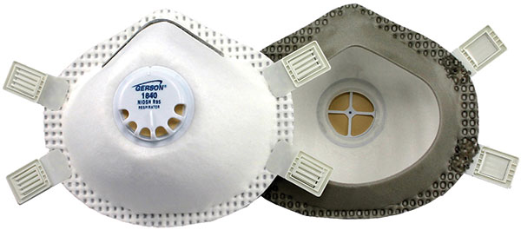
Respirators
Previously
Employers must provide Personal Protective Equipment (PPE) required by labeling & ensure respirator fits correctly
Revision
Adopts by reference a subset of OSHA’s standard for respirators if required by label (including filtering facepieces) - fit test, medical evaluation, training
Notes:
The new proposed EPA worker protection rule changes are in a review period at this time.

Slide 29
Decontamination Supplies
Previously
Employers must provide “sufficient amount of water so that the workers/handlers may wash thoroughly”
Revision
Provide 1 gallon of water for each worker and 3 gallons for each handler and each early-entry worker
HANDLERS & EARLY ENTRY WORKERS
WORKER
Notes:
The new proposed EPA worker protection rule changes are in a review period at this time.

Slide 30
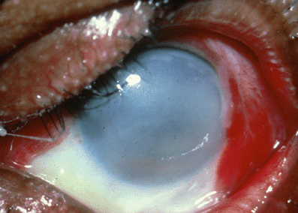
What Irreversible Eye Damage Looks Like
Notes:
The new proposed EPA worker protection rule changes are in a review period at this time.

Slide 31
Emergency Eye-Flush
One system per mix/load site (not based on number of handlers)
Immediately available to handler
Eye-flush must be:
System capable of delivering gently running water at 0.4 gal/min for at least 15 min OR
At least 6 gallons of water in containers suitable for providing a gentle eye-flush for about 15 min
Notes:
The new proposed EPA worker protection rule changes are in a review period at this time.

Slide 32
Emergency Assistance
Previously
Employers must provide “prompt” transportation to an emergency medical facility for workers or handlers who may have been exposed to pesticides
Upon request, employers must provide certain information, if available, to the exposed person or medical personnel
Revision
Retain “prompt” for provision of transportation
Require employers to provide for each product the SDS and specific information about the product, as well as the circumstances of the application and exposure, to treating medical personnel
Notes:
The new proposed EPA worker protection rule changes are in a review period at this time.

Slide 33
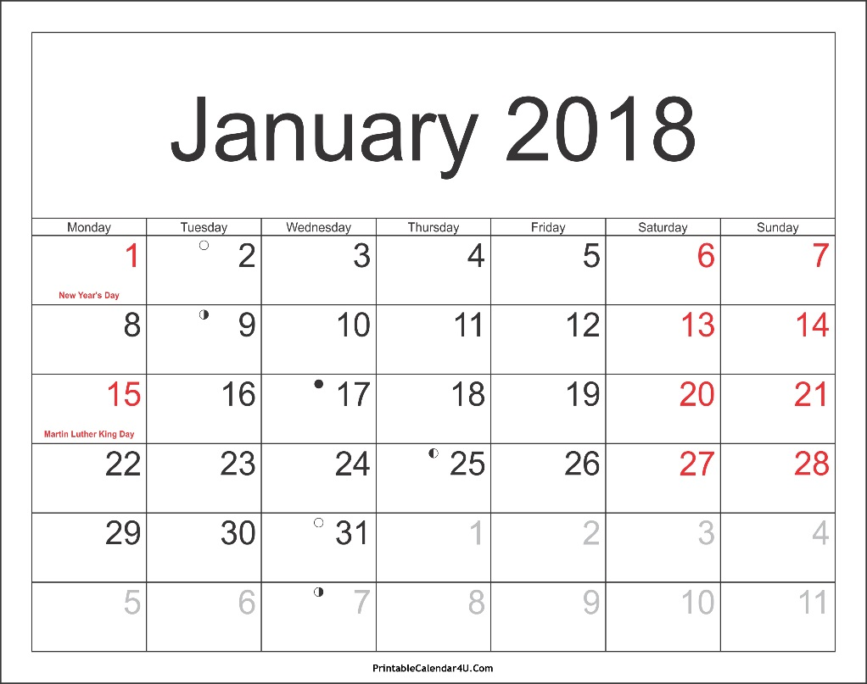
New Protection During Applications in Outdoor Production
Handlers’ AEZ requirements are NOT effective until January 2, 2018
Key Issue: What does “suspend a pesticide application” mean for the purposes of the WPS and the AEZ requirement?
Notes:
The new proposed EPA worker protection rule changes are in a review period at this time.

Slide 34
Application Exclusion Zones in Outdoor Production
Previously
During pesticide applications, workers and others are prohibited from being in:
The treated area - for farms and forests
The treated area and areas adjacent to treated areas (entry-restricted areas) – for nurseries
 | Treated area (green)
Entry-restricted area (purple)
Notes:
The new proposed EPA worker protection rule changes are in a review period at this time.

Slide 35
Application Exclusion Zones in Outdoor Production
Revision
Establishes application exclusion zones (AEZ) based on distance from the application equipment for farms, forests, and nurseries
Agricultural employers must keep workers and other persons out of the treated area & AEZ that are WITHIN the boundary of the establishment owner’s property
Handler must suspend application if persons are in AEZ. Requirement to suspend application is NOT limited by the boundary of the establishment owner’s property [Delayed implementation]
 |  |  |  | Treated area
 |  |  |  | (green)
Application exclusion zone
(purple)
Notes:
The new proposed EPA worker protection rule changes are in a review period at this time.

Slide 36
AEZs in Outdoor Production (170.405(a)(1))
100 foot AEZ
Applied aerially, by air blast or with a spray quality smaller than medium
Applied as a fumigant, smoke, mist or fog
25 foot AEZ
Applied other than above & sprayed from a height of >12 inches from planting medium with spray quality of medium or larger
No AEZ
Applied otherwise
Notes:
The new proposed EPA worker protection rule changes are in a review period at this time.

Slide 37
Droplet Size and Relation to AEZ ASABE Standard S-572.1
Sidebar 4. Spray quality categories
ASABE Standard S-572-1ª
Category (symbol)^{b} | Color Code^{c}
Extra Fine (XF) | Purple
Very Fine (VF) | Red
Fine (F) | Orange
Medium (M) | Yellow
Coarse (C) | Blue
Very Coarse (VC) | Green
Extra Coarse (XC) | White
Ultra Coarse (UC) | Black
Notes:
The new proposed EPA worker protection rule changes are in a review period at this time.

Slide 38
Resources
Pesticide Education Resource Collaborative http://pesticideresources.org//index.html
WPS Revisions – EPA https://www.epa.gov/pesticide-worker-safety/revisions-worker-protection-standard
NC Dept. of Agriculture & Consumer Services
Structural Pest Control & Pesticides Division
Pesticides Section
http://www.ncagr.gov/SPCAP/
Notes:
The new proposed EPA worker protection rule changes are in a review period at this time.

Slide 39
For More Information:
On the web:
www.ncagr.gov/SPCPD/pesticides
Contact:
(919) 733-3556
Notes:
The new proposed EPA worker protection rule changes are in a review period at this time.

